Slide 1
2-4-18 Capstone A
Jacob, Kaitlin, Trace

Slide 2
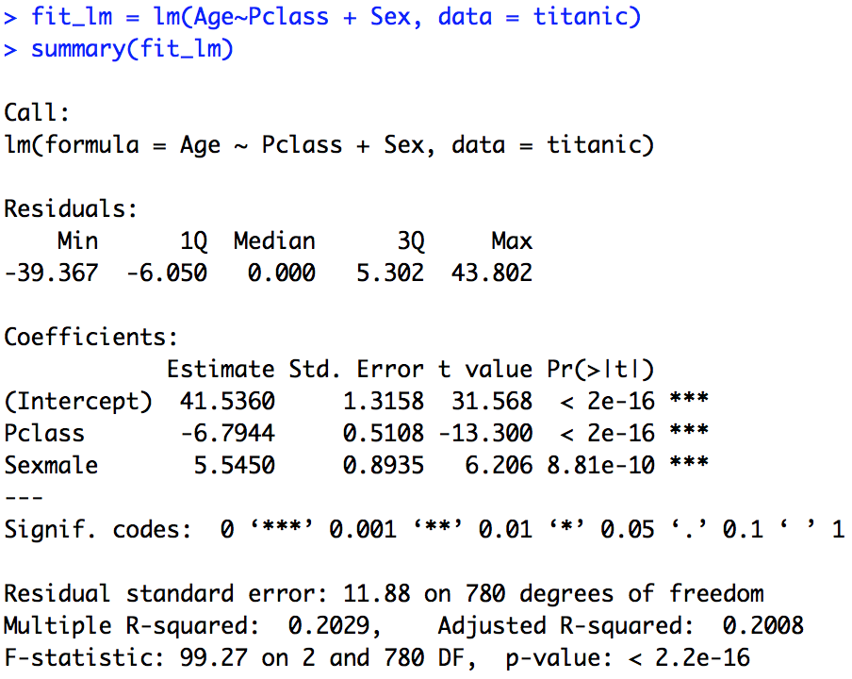
Imputation of Age

Slide 3
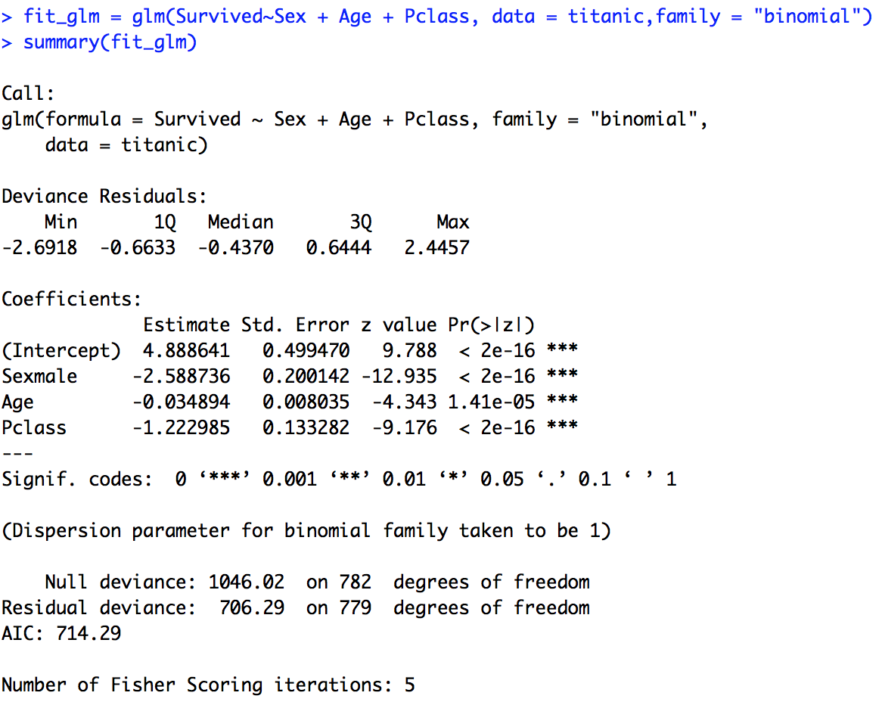
Fitting Logistic Regression

Slide 4
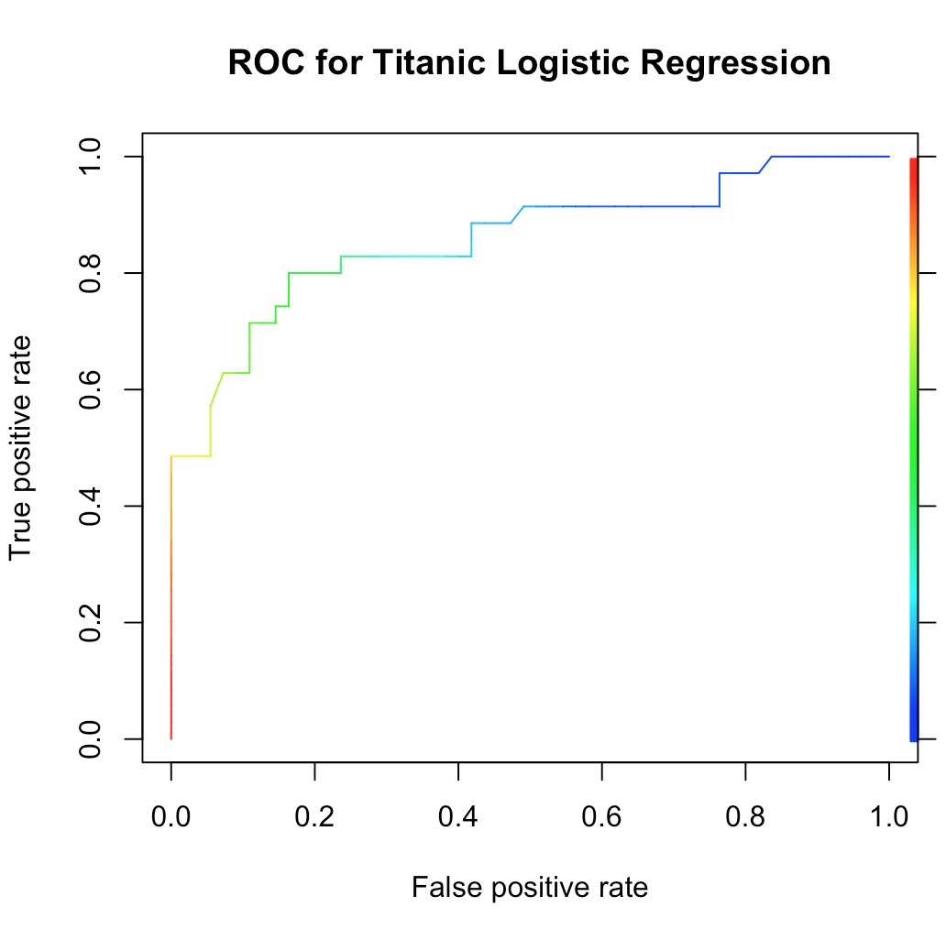
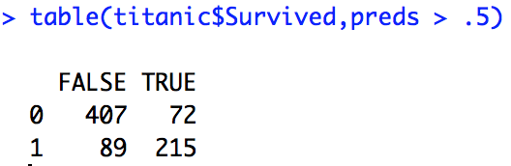
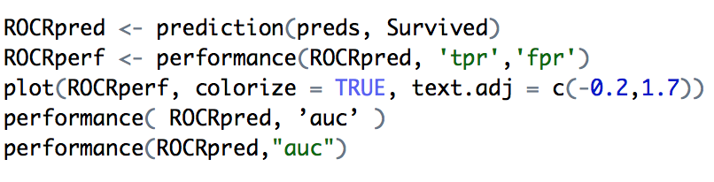
Confusion Table: Titanic Data
Predicted
 | Survived | Died
Survived | 407 | 72
Died | 89 | 215
Actual
AUC: .857
Total | 783
Sensitivity | 0.84968685
Specificity | 0.70723684
Correct Classification Rate | 0.79438059
Mis-Classification Rate: | 0.20561941

Slide 5
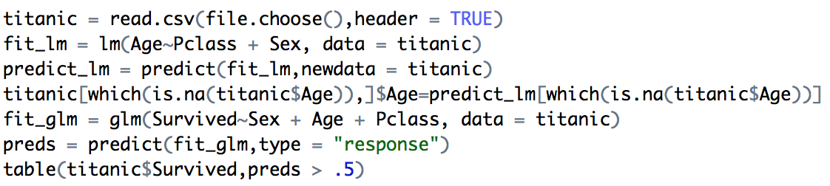
RCODE
Need Package: ROCR

